Slide 1



Slide 2

“English Accent Trainer For Non-Native Speakers” (A Machine Learning Model for Accent Classification)
Supervised by:
Mr.Najam Dar
Group Members:
Usama Abbas (SP17-BCS-037)
Shabeer Ahmad (SP17-BCS-032)
Department of Computer Science
COMSATS University Islamabad, Attock Campus

Slide 3
Outline
_______________________________
Introduction
Problem Statement
Related Work / Applications
Objectives
Benefits
Requirement Specification
Methodology
Project Design
Implementation
Modern tools
Conclusion
Future Work
References
_______________________________

Slide 4
Introduction
Accent of a person is the distinctive way of pronouncing a language, it especially depends on the particular country, region and social class.It also tells about the educational, cultural and social background.
Accent in English matters a lot now a days, we need it in education sector, working in other countries where accent is different and very other same fields.
People suffer alot in accent mismatch,people spend alot in passing exams like IELTS and also face problem in communication with collegues when working foreign countries.
English is treated as International Language and most of the english speakers are Non-Native speakers. The problem faced by people is that accent disimilarity, lack in communication and tests required for higher studies.

Slide 5
Continued...
People don't even know how much their accent matches to their interested accent and how they will evaluate the progress.
They have to join coaching classes and manual way of learning so there is a need of the system which can evaluate, train people in native accents.
English is treated as International Language and most of the english speakers are Non-Native speakers. The problem faced by people is that accent disimilarity, lack in communication and tests required for higher studies.
Our application English Accent Trainer is the solution to the problem.
It gives user an interface to test its accent similarity, by “Accent Similarity Test” which includes Machine Learning and Natural Language Processing.

Slide 6
Continued...
Accent Similarity Test includes the process of performing Natural Language Process techniques and Machine Learning Techniques to extract the feature required for performing this test.
Accent Similaty Test is the core and most imporatnt part of this application because whole thing depends o this.
User will read a given passage and his/her voice will be recorded and using that audio clip, our system will perform this test.
Threshold for performing this test is Native Speaker's audio data-set.
Results of this test is displayed in the form of a percentage graph.

Slide 7
Continued...
After that application will teach the accent to te user by practice exercises.
Practice Exercises contains the audio clips of Native Speakers.
User can listen to these clips and can learn the accent.
This is an easy way to test your accent level with a testified system with accurate results.

Slide 8
Problem Statement
English language is considered as international language and it consists of hundreds of accents.
People living in different areas in the world are keen to learn english.
Every region has its own accent, even people living in the same state has different accent with respect to their demographics.
People working and studying foreign faces a lot of problem in communication and most of the places there is a requirement of IELTS test.

Slide 9
Problem Statement
We believe that accent identification can benefit from machine learning, in particular convolutional neural networks given their relevance to sequential data. This project attempts to improve the accuracy
of accent identification in spoken English.

Slide 10
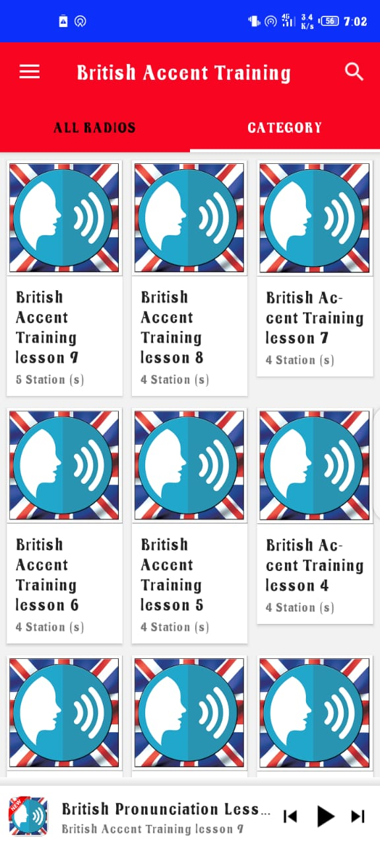
Related Applications

Slide 11
Problems
British Accent Training:
User Interface is not friendly.
No mechanism for testing accent similarity.
Complex mechanism.

Slide 12
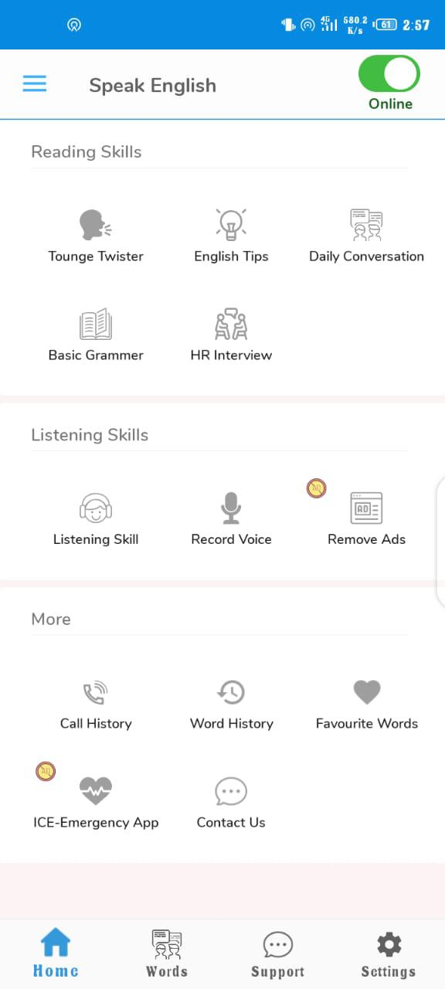
Speak English

Slide 13
Problems
Speak English Application Problems:
Irrelevant Information
Unrelated formalities during usage of app not necessary for accent
Difficult for those wjho are technology literate.

Slide 14
Objectives
Providing application for English Accent Detection and learning accents
Accurately detect the accent of speaker.
Detecting Noise and performing noise removal.
Detection of pauses and silence and their removal.
Converting mp3 to wav.
Extracting MFCC features.
Build a Machine Learning Model for Accent Classification.

Slide 15
Benefits
Provides easy way to check Accent Similarity using Machine Learning Model.
Students assistance in tests like IELTS and for jobs requirements in foreign.
Adds up in the field of research of more robust ASR system which include Accent Classification.
Helps to build more effective automated Speech Recognition Systems.

Slide 16
Requirements Specifications (Functional Requirements)
Signup Requirement
Login Requirement
Accent Similarity Test
Similarity Index
Practice Exercises

Slide 17
Requirements Specifications (Non-Functional Requirements)
Compatibility
Maintainability
Availability
Scalability
Robustness
User-friendly
Usability

Slide 18
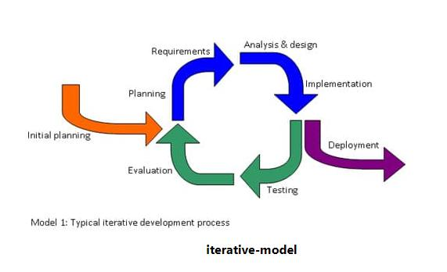
Methodology
English Accent Trainer for Non-Native Speakers is developed based on iterative model.
Because this model focuses on an initial, simplified implementation, which then progressively gains more complexity and a broader feature set until the final system is complete.

Slide 19
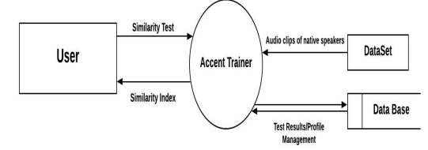
Project Design (Context Diagram)

Slide 20
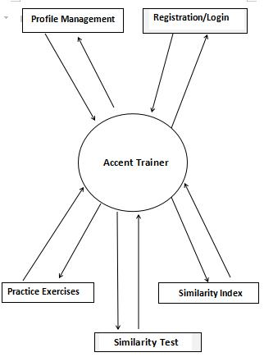
Project Design (Data Flow Diagram Level 0)

Slide 21
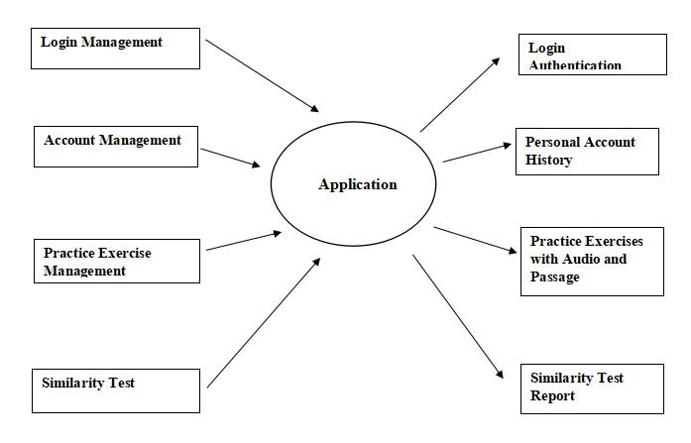
Project Design (Data Flow Diagram Level 1)

Slide 22
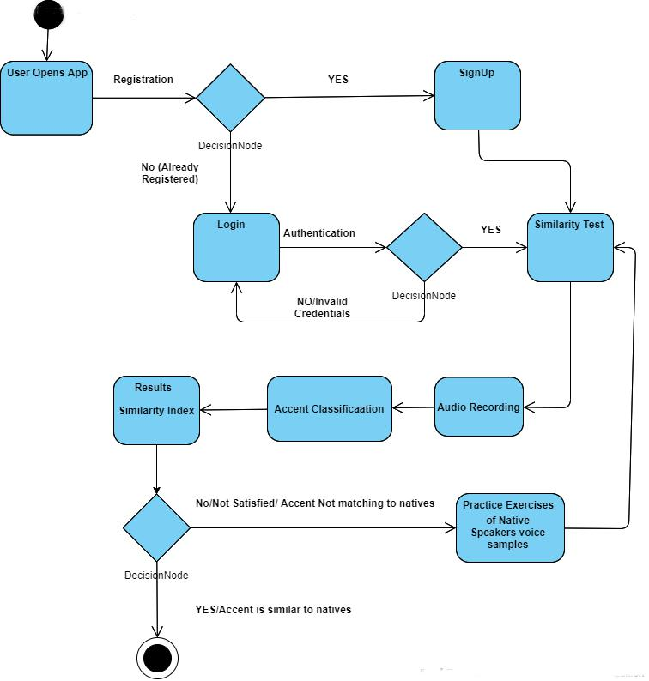
Project Design (Activity Diagram)

Slide 23
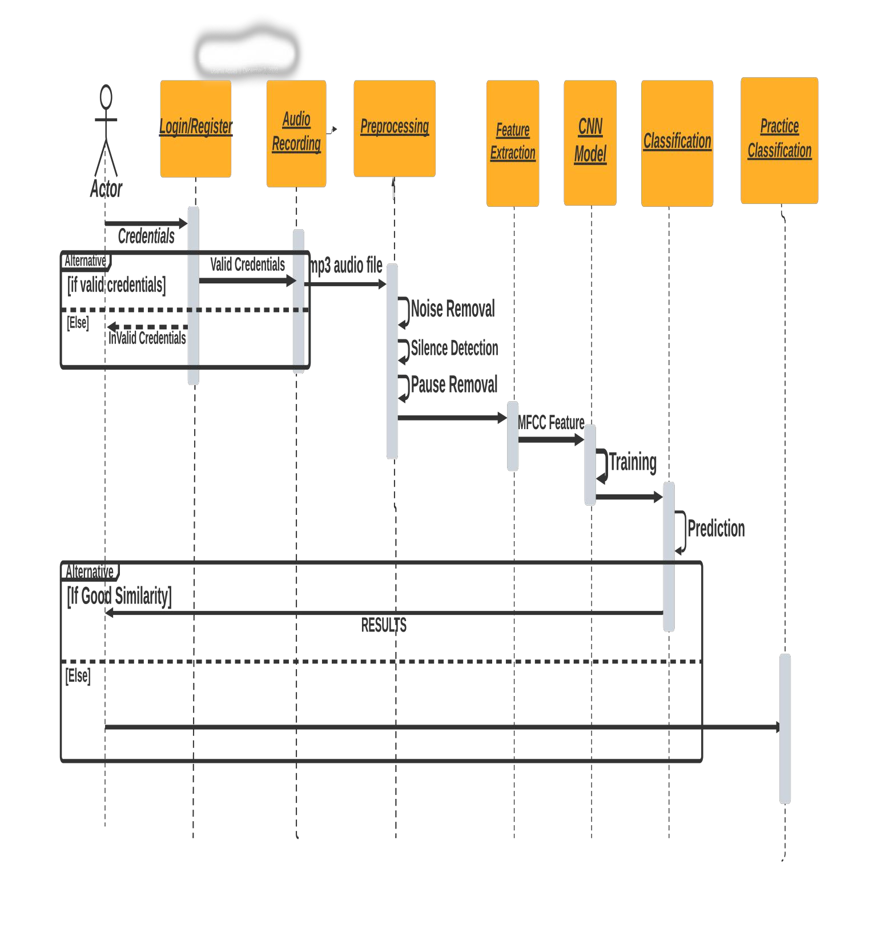
Project Design(Sequence Diagram)

Slide 24
Implementation
Pre Processing:
Converted Audio mp3 to wav form
Noise Removal
Silence/Pause Detection

Slide 25
Implementation
Feature Extraction:
Extracting MFFC features
Resize MFCC
Label MFCC
Split Data into Training and Testing data
Standardize MFFC features

Slide 26
Implementation
Training CNN Model
Feeding the Extracted MFCC to CNN as input vector
Consist of 7 Layers
Accent Classification in 6 classes
Model Trained: On the basis of this training model classifies user accent.

Slide 27
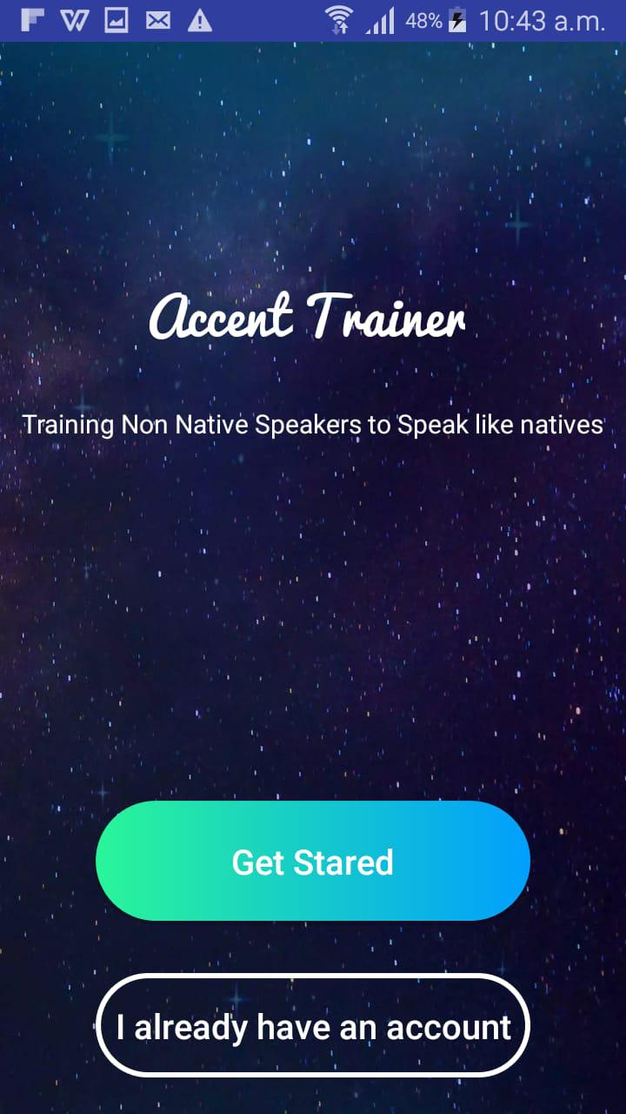
User Interface
Home Screen

Slide 28
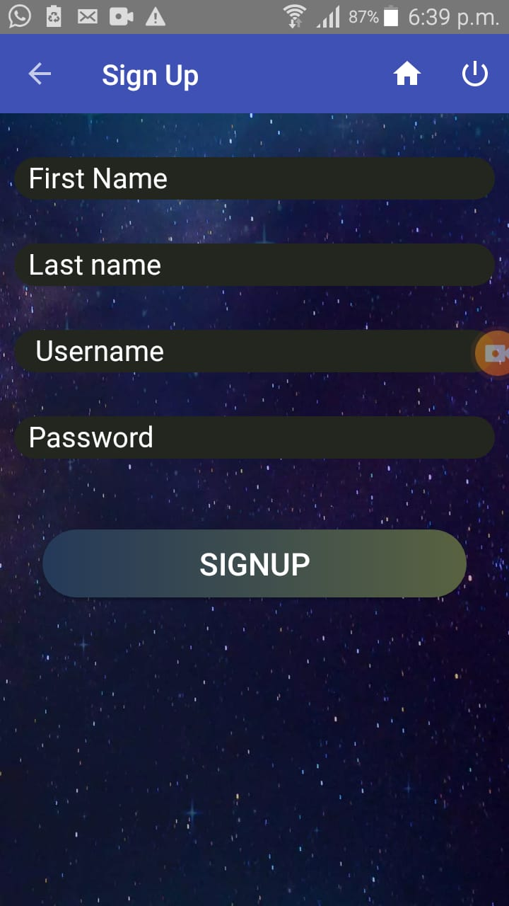
SignUp

Slide 29
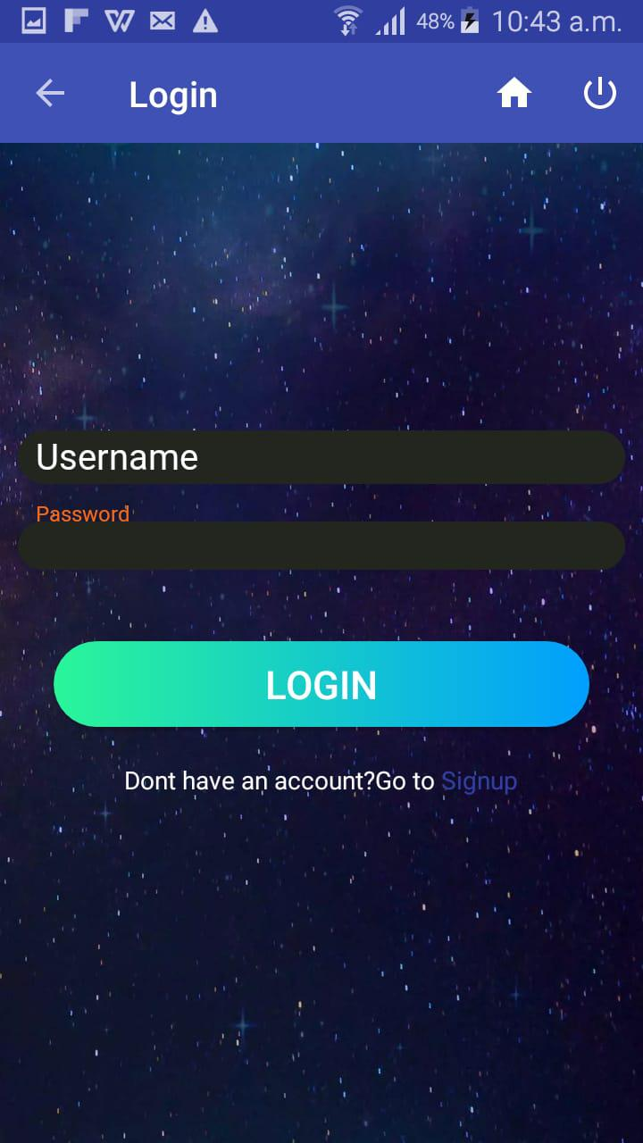
Login

Slide 30
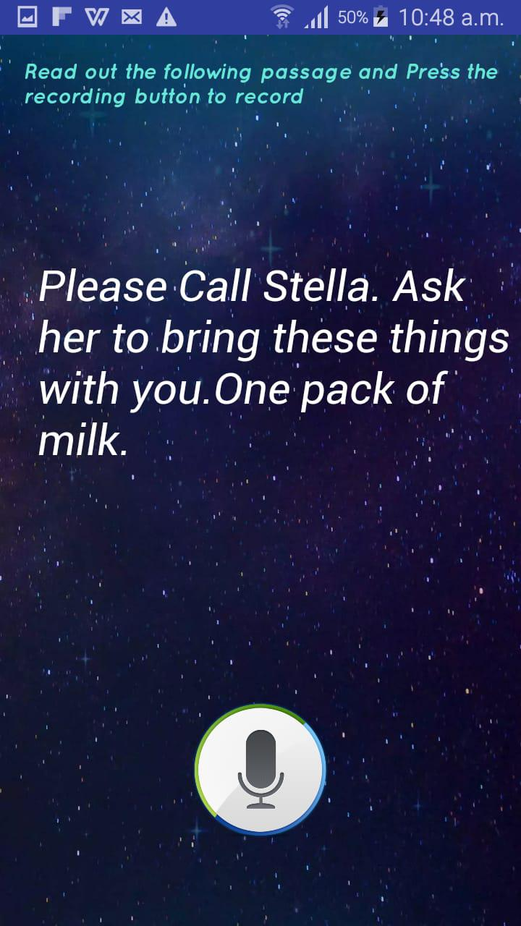
Recording Audio Acivity

Slide 31
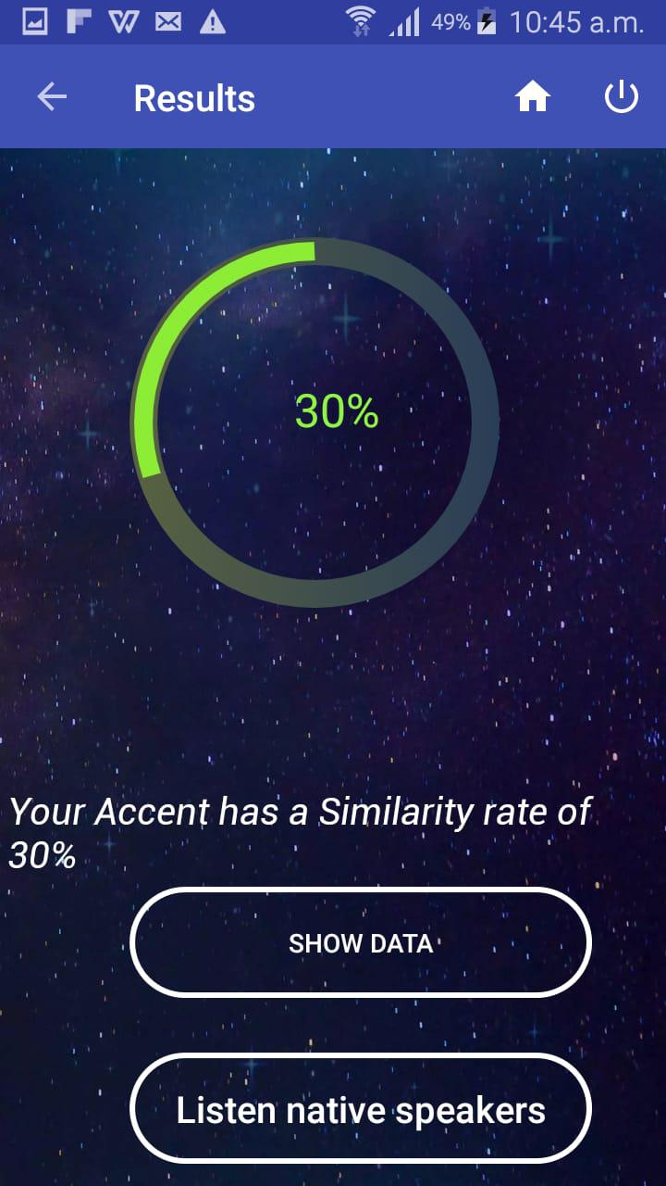
Similarity Index

Slide 32
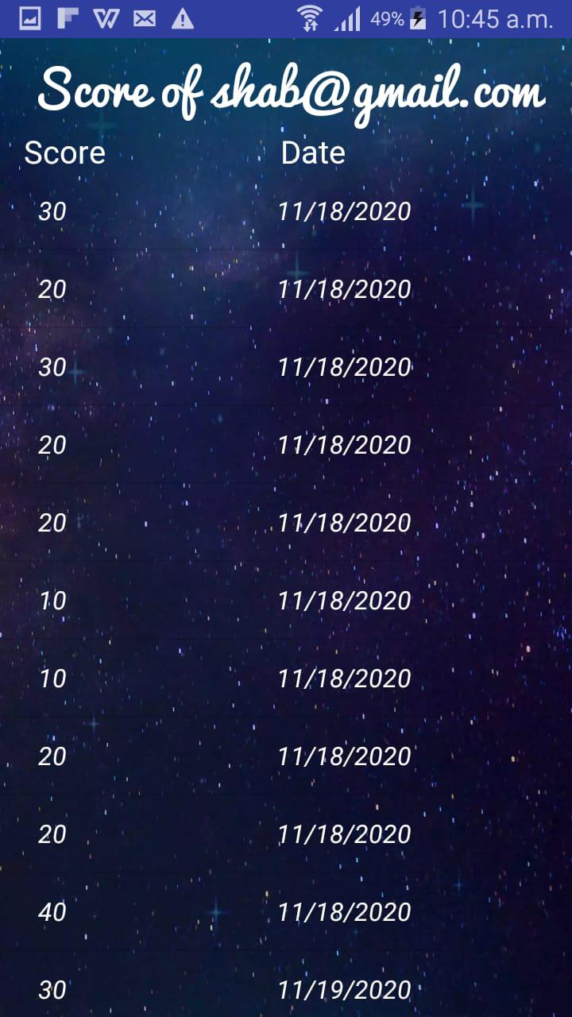
Personal Scores

Slide 33
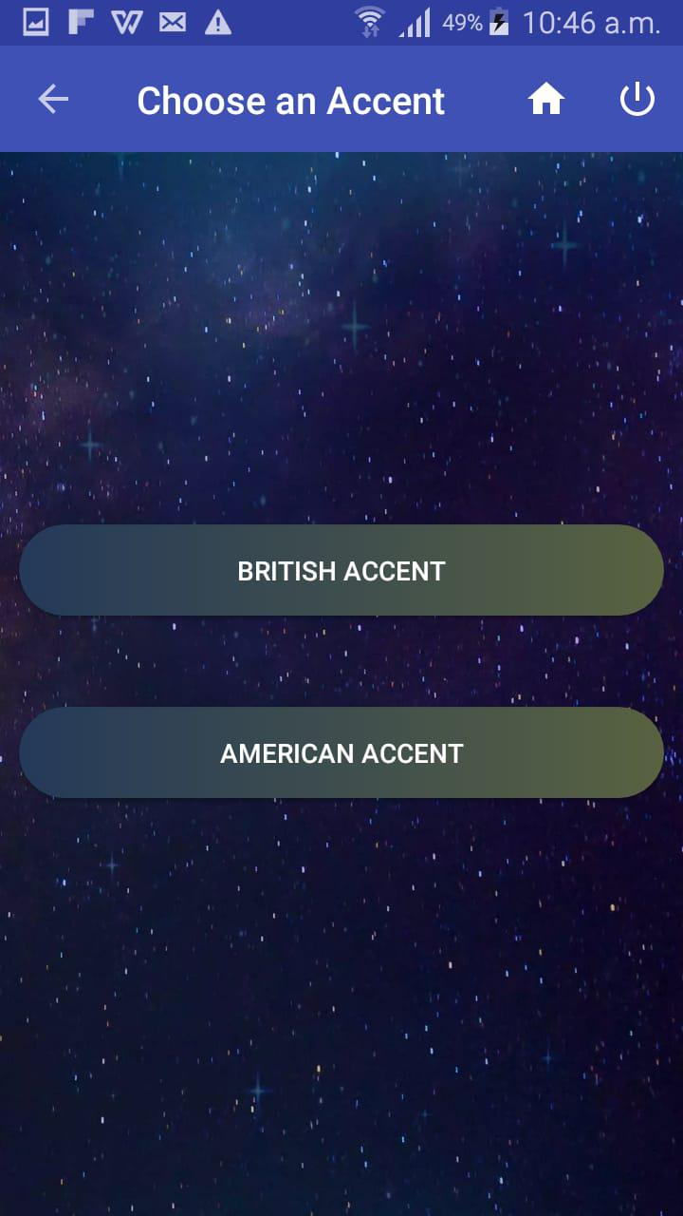
Accent Selection for Test

Slide 34
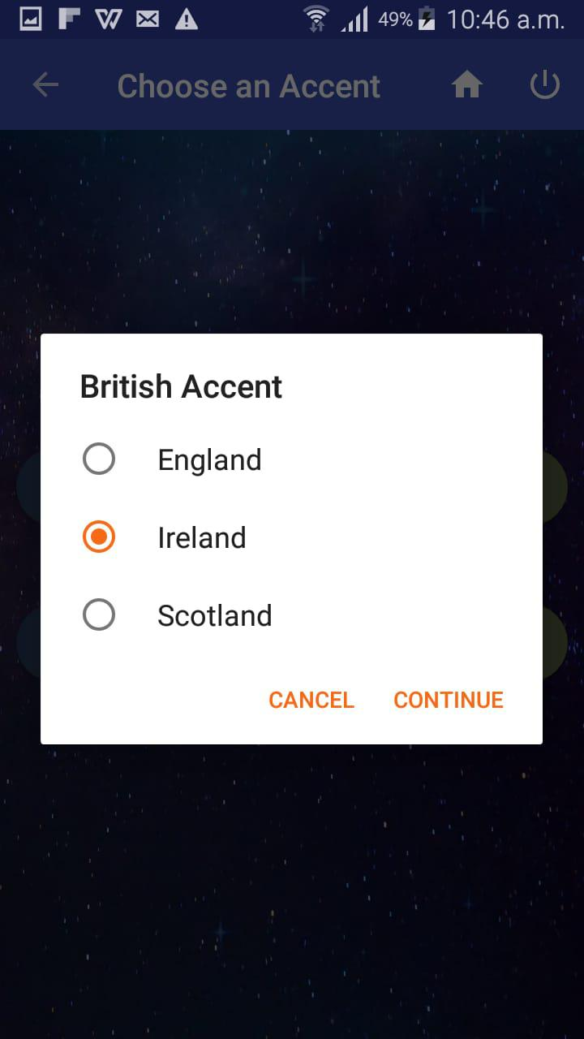
Accent Selection for Test

Slide 35
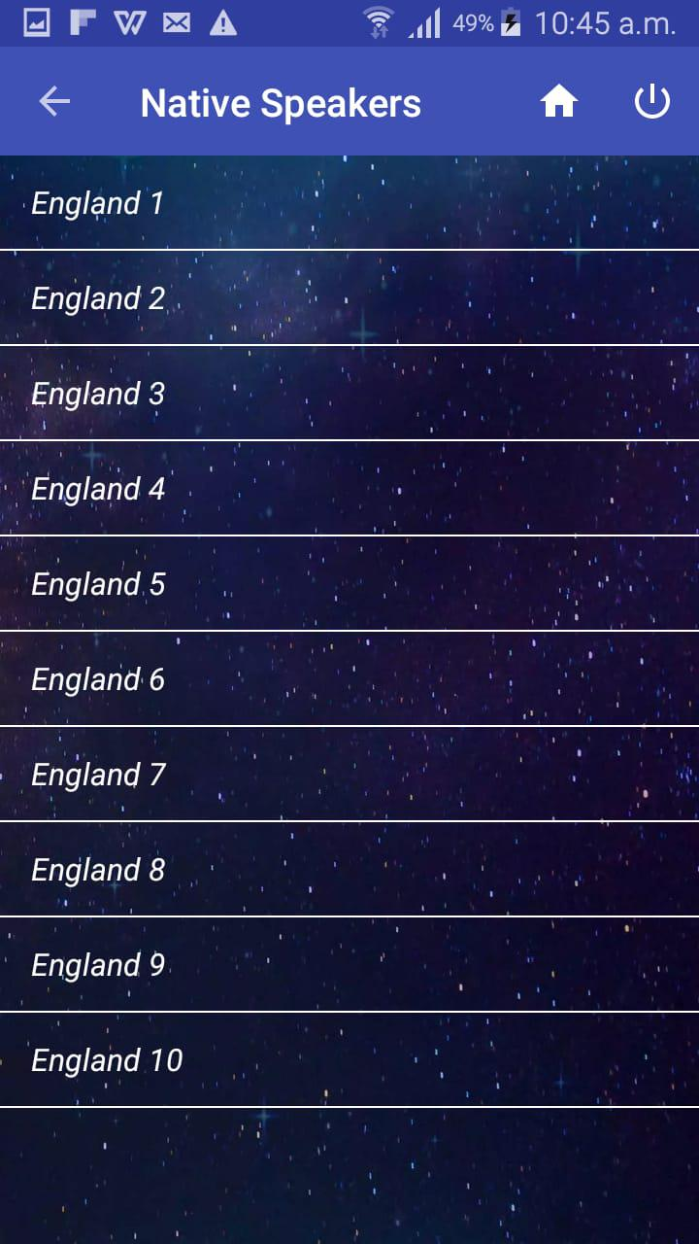
Profile Settings Activity

Slide 36
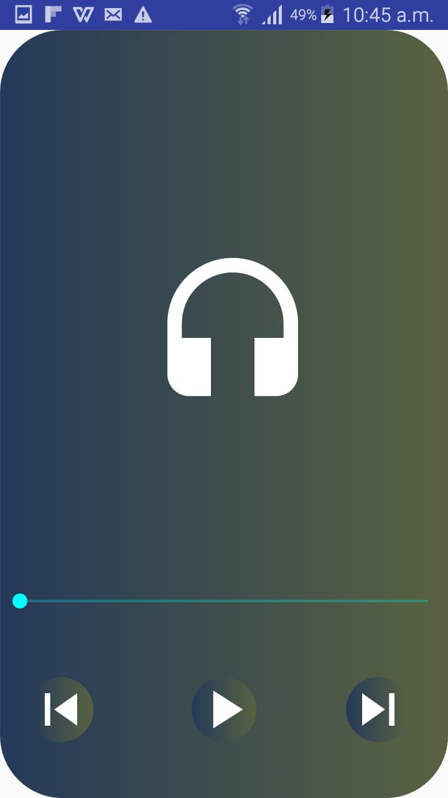
Audio Player For Eercise

Slide 37
Modern Tools
Development Tool:
Android studio-IDE
PyCharm
Jupiyter
Star UML-UML diagrams
MS Word-Documentation
PowerPoint-Presentation
Programming Language:
Java
Xml
Python

Slide 38
Results
We were able to :
Classify 6 classes of English accents.
Achieved 90% training accuracy.
Achieved 88% testing accuracy.
Able to provide similarity index with high accuracy.

Slide 39
Conclusion
The work in the field of Accent Classification has increased despite the progress of automatic speech recognition (ASR) systems that have led to assistants like Alexa and Siri, accent is still an issue in developing robust ASR systems that deliver high performance across diverse user groups.ASR systems like Google Now and Siri are usually trained on and perform best for these accents.

Slide 40
Conclusion
The results from our project show the capabilities of deep neural network architectures to classify both native and non-native english speakers. Using MFCC extracted from recordings, our CNN model was able to perform the classification the best among the algorithms we tested. It also turned out that audio pre processing were major factors in affecting performance of CNN.
A Training Accuracy of 90% and Testing Accuracy of 88% has been achieved.

Slide 41
Future Work
This model will be very useful in ASR system to make them robust.
ASR systems are lacking because they are unable to understand the same thing pronounced in different accent.
We can systems like Alexa, Siri and other IOT systems more robust.
It can provide a lot of value in IOT, Home/Work Places Automation.

Slide 42
Cont...
Accent Classification for any other growing language.

Slide 43
References
Abulsaoud Hanani,(2012), Human And Computer Recognition Of Regional Accents And Ethnic Groups From British English Speech.
Muhammad Rizwan, David V. Anderson, (2017), A weighted accent classification using multiple words.
Jordan J. Bird, A Ekart, Elizabeth F. Wanner, Diego R. Faria,(2019), Accent Classification in Human Speech Biometrics for Non-Native and Native Speakers
Rishabh Upadhyay, Simon Lui, (2018), Foreign English Accent Classification Using Deep Brief Networks.

Slide 44
Thank You!

Slide 45


